Slide 1

Data Architecture Design
for Instacart Dataset
DAMG7370 Final Project - Group 1
GitHub Link
Team Members:
Sujiitra Murukeshan 002643735
Aishwarya Sreenivasan 002832662
Thamashi Kumarasinghe 002651640
Tejas Samudrala 002700327

Slide 2
Objective
To design and implement an end-to-end data architecture pipeline for the Instacart dataset using Azure services, enabling seamless data ingestion, transformation, and visualization.
This project aims to demonstrate a modern, scalable data engineering workflow by integrating Azure Blob Storage, Data Factory, Databricks, Synapse Analytics, and Power BI. The goal is to efficiently manage raw data, perform advanced transformations, and deliver actionable insights through interactive dashboards.

Slide 3
Tools Used
Azure Blob Storage
Data Factory
Databricks
Data Lake Gen2
Synapse Serverless SQL
Power BI

Slide 4
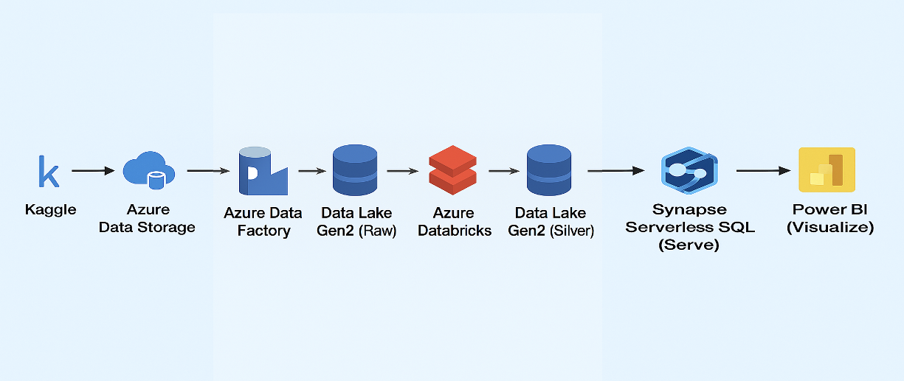
Data Architecture

Slide 5
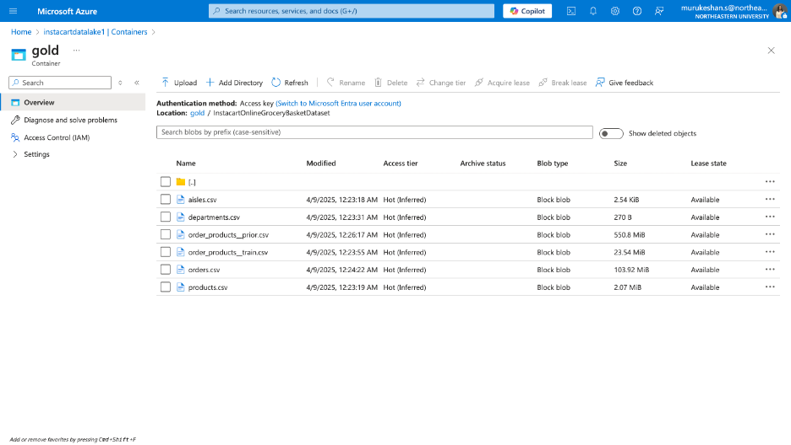
Data Source
Source: Kaggle Dataset - Instacart Online Grocery Basket Analysis
Format: Multiple CSV files (orders, products, aisles, departments, etc.)
Size: Large - Not suitable for direct GitHub usage
Upload Method: Downloaded locally and uploaded to Azure Blob Storage

Slide 6
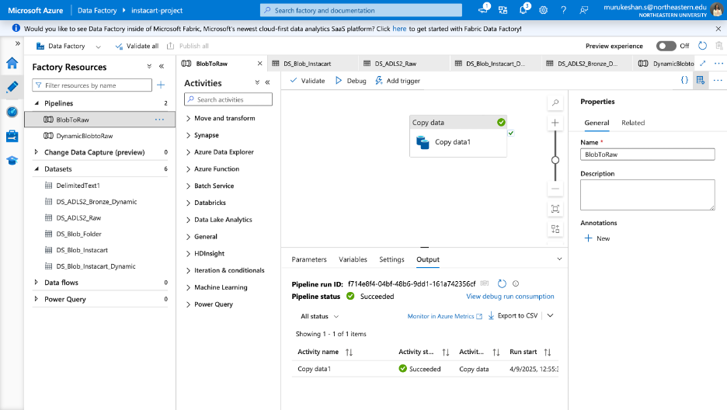

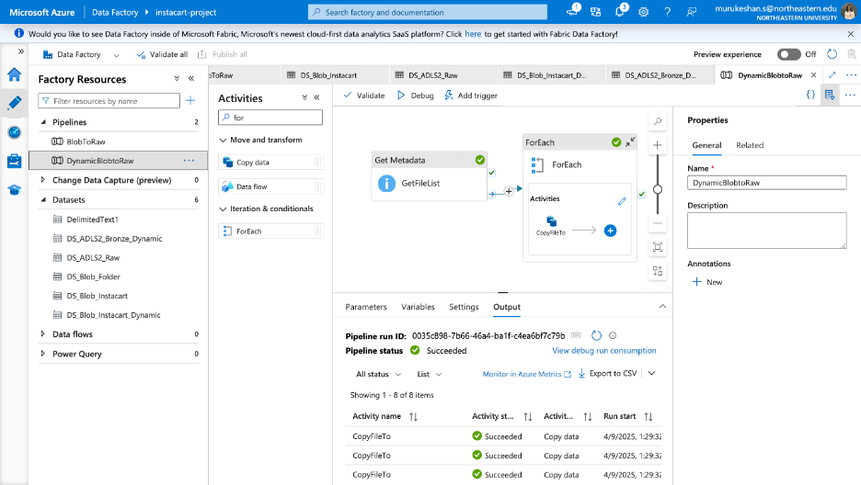
Data Ingestion Layer
Platform:
Azure Data Factory
Source: Azure Blob Storage (Bronze Layer)
Destination: Azure Data Lake Gen2 (Raw Zone)
Features:
Metadata-driven pipeline
Copy Data activity
Support for dynamic file loading

Slide 7
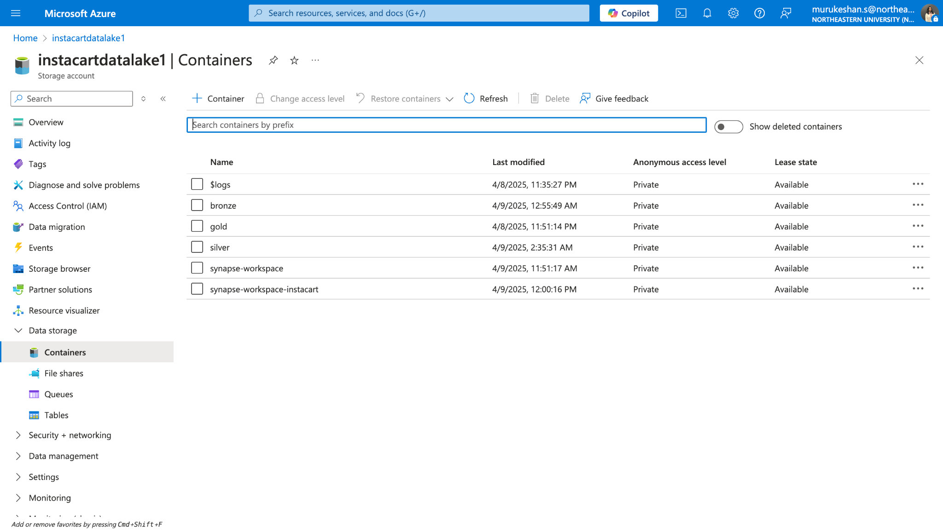
Storage Structure
Raw Layer:
Bronze container (raw CSVs)
Processed Layer: Silver container (cleaned Delta/Parquet files)
Analytics Layer: Logical gold layer (SQL views in Synapse)

Slide 8
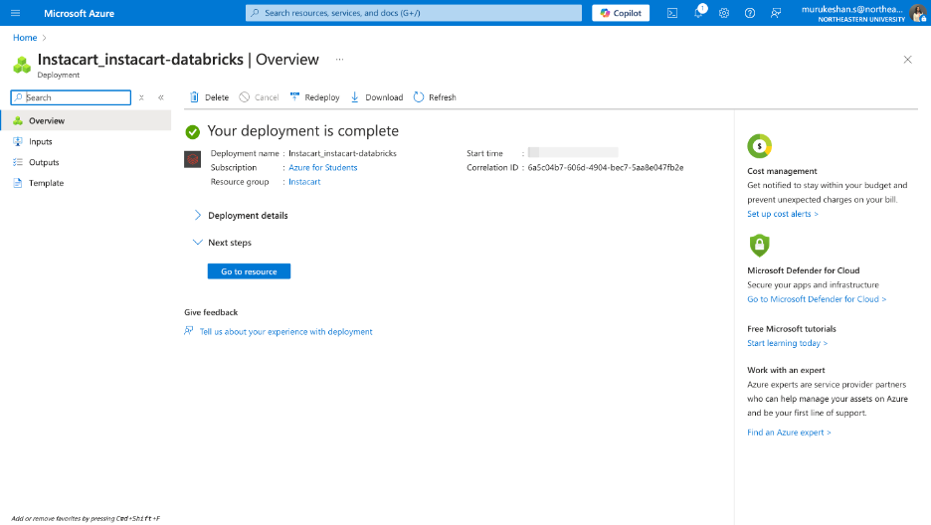
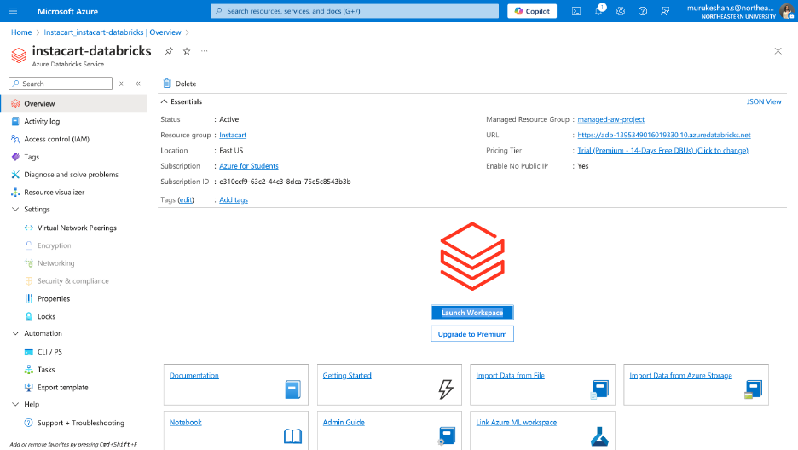
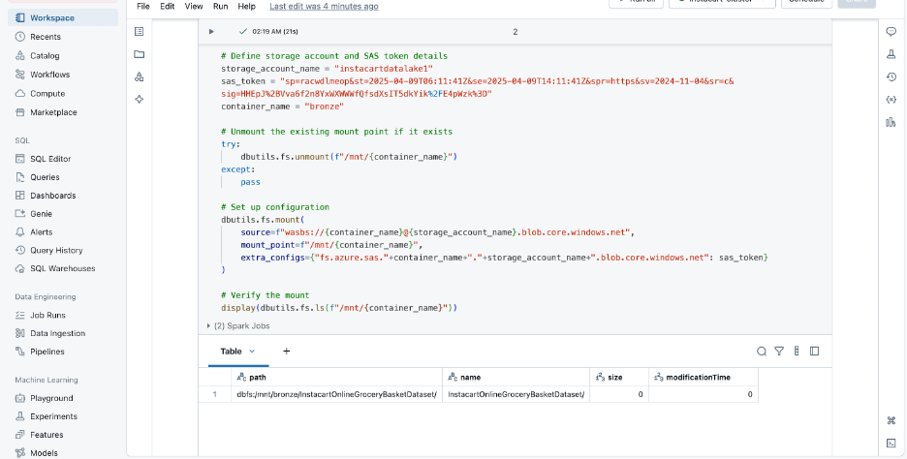
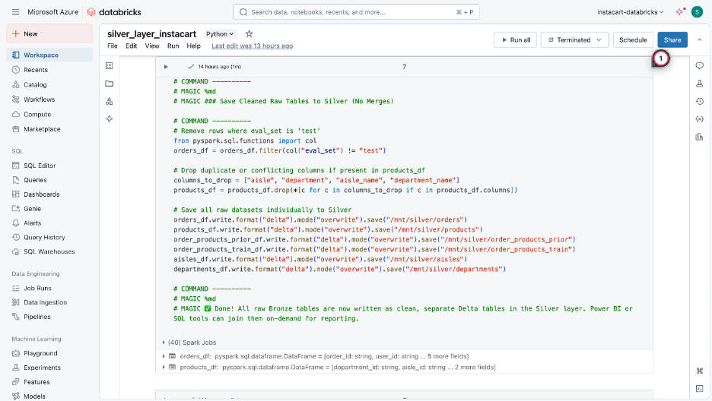
Data Transformation Layer
Tool: Azure Databricks (PySpark)
Activities:
Mount blob containers using SAS token
Load and clean each CSV file
Save as optimized Parquet/Delta format
Handle missing values, standardize types

Slide 9
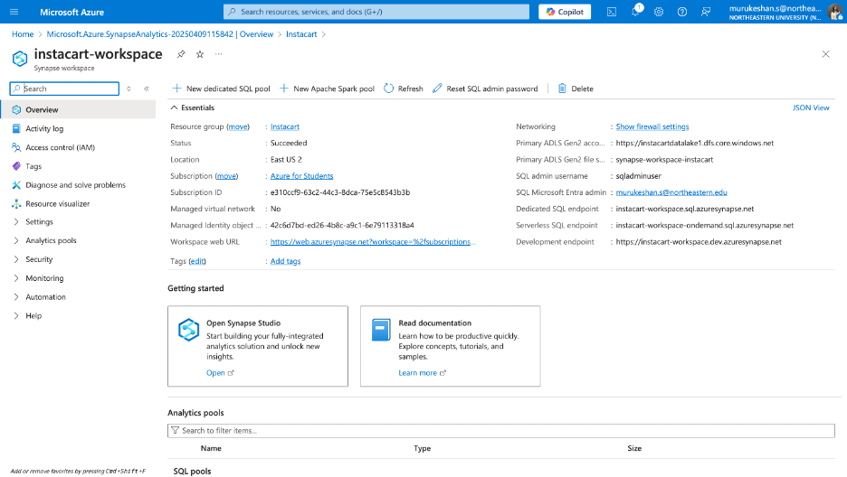
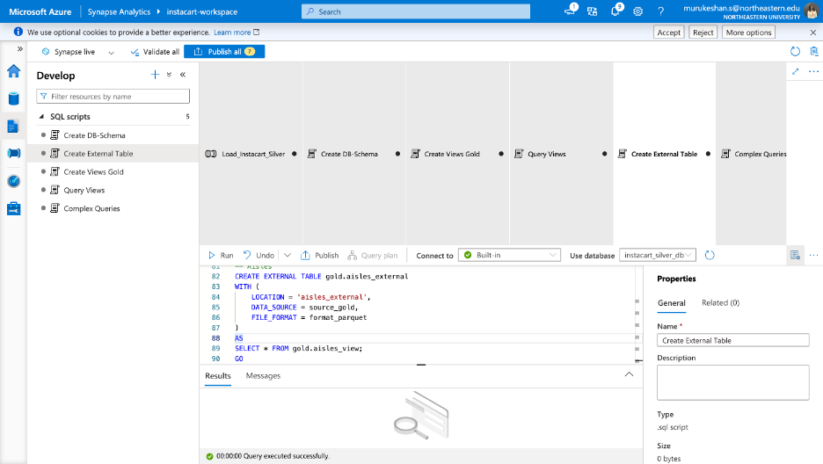
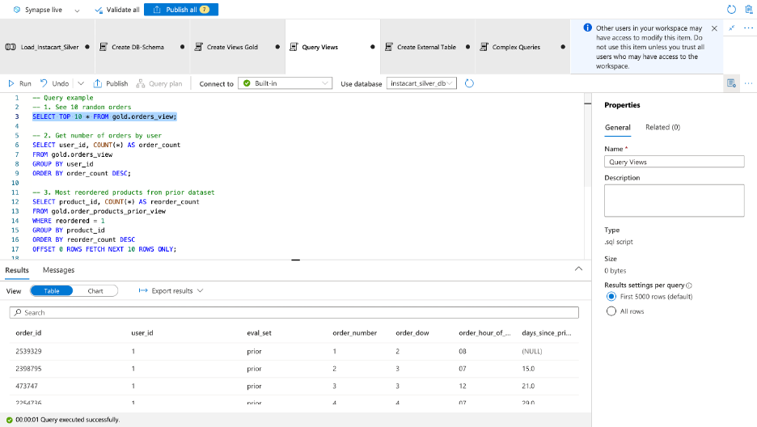
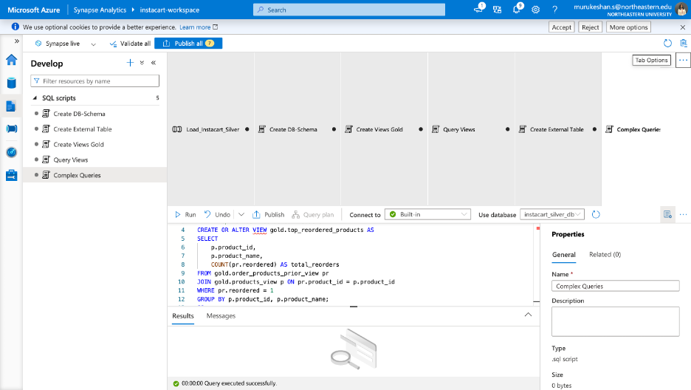
Serving Layer- Synapse Analytics
Tool: Azure Synapse Serverless SQL
Data Source: External data source to Silver container
Access Method: OPENROWSET with WITH schema definitions
Views Created:
orders_view, products_view, order_products_prior_view, etc.
Analytical views: top_reordered_products, orders_by_dayofweek, etc.

Slide 10
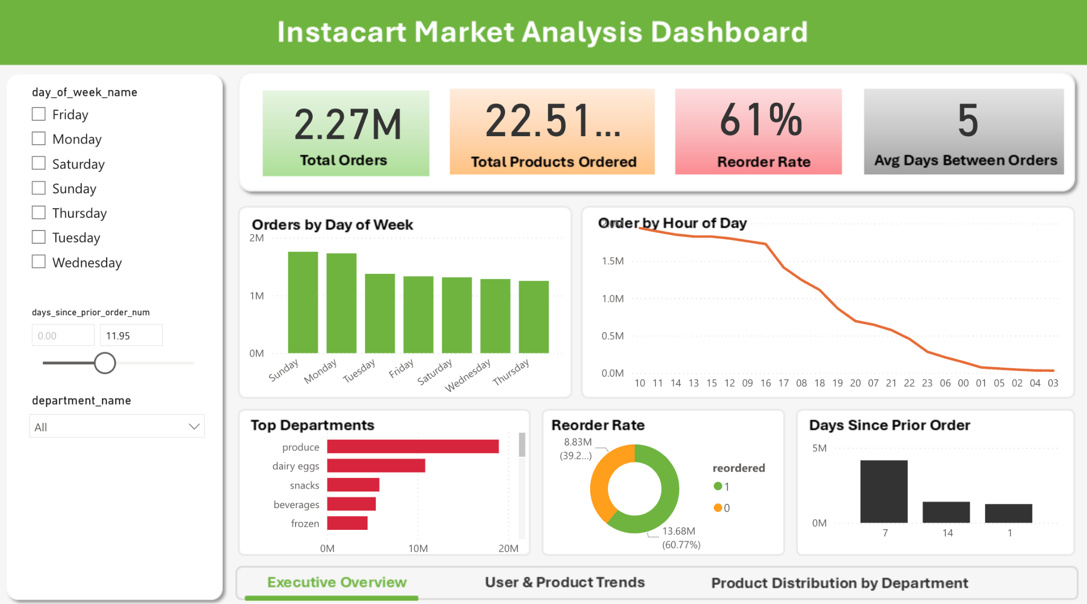
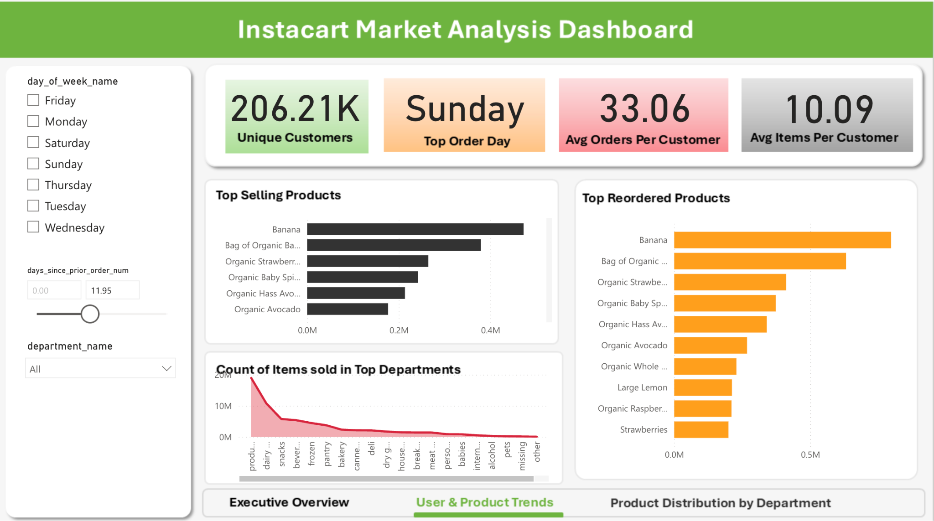
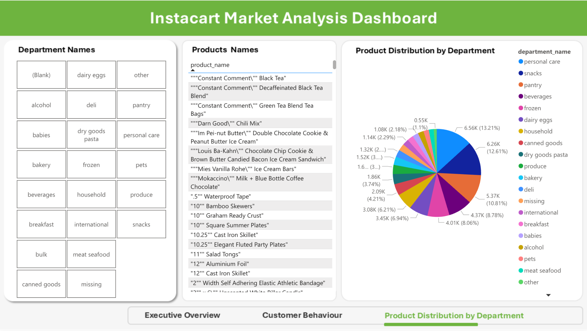
Visualization- Power BI
Connection: Connected to Synapse via Serverless SQL endpoint
Built dynamic visuals with slicers for day, department, user, and product
Key Visuals Built:
Orders by Hour of Day – identifies shopping peak hours
Top Departments by Day – tracks weekly performance patterns
Reorder Rate – shows customer loyalty trends, etc
Used DAX to calculate Total Orders, Reorder Rate, and Avg Days Between Orders
Sharing:
Published to Power BI Workspace

Slide 11
Learnings & Challenges
⚠️ Challenges
Parquet data type mismatches
SAS token + mounting issues
No ORDER BY in Synapse views
Power BI Service limitations
Unresponsive slicers initially
💡 Learnings
Layered architecture = scalable + modular
Synapse views simplified Power BI consumption
Relationships drive interactivity
DAX > for custom, dynamic metrics

Slide 12
Conclusion
Architecture Summary
Bronze: Ingested raw data to Data Lake and used Data Factory to manage pipeline steps
Silver: Cleaned & transformed in Databricks (notebooks)
Gold: Created views + external tables in Synapse for reporting
Connected to Power BI via serverless SQL endpoint
Key Highlights:
Successfully Designed and Implemented a full data pipeline and Reporting Dashboard using Azure ecosystem
Delivered an Interactive Power BI dashboard that offers actionable business insights
Architecture is cloud-native, modular, and built for scalability

Slide 13
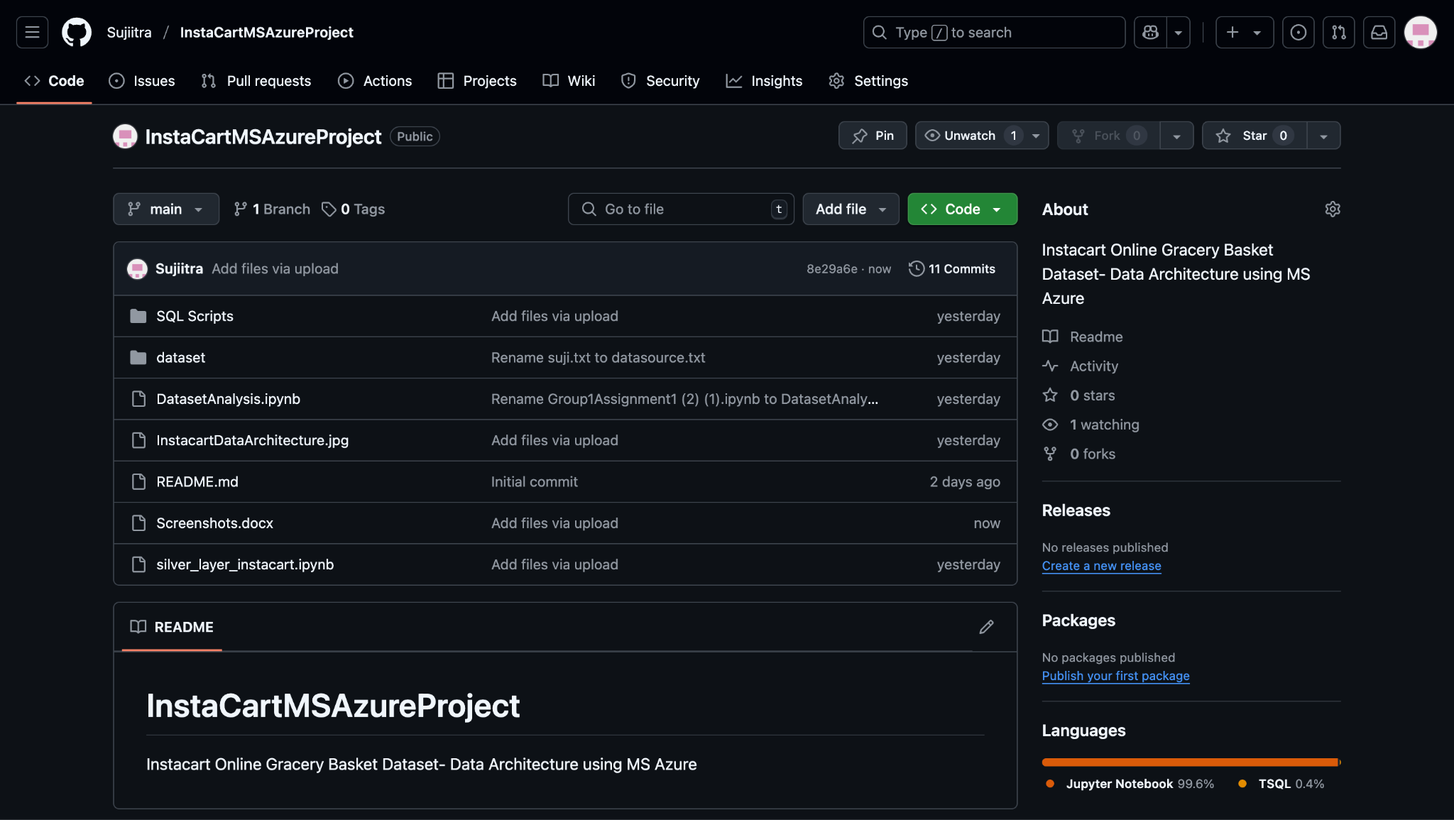
Artifacts
GitHub Repo: https://github.com/Sujiitra/InstaCartMSAzureProject
Included Artifacts:
SQL Queries – Scripts used in Azure Synapse (staging, transformation, serving)
Silver Layer Notebook – Python notebook using PySpark in Databricks
Initial EDA & Analysis – Jupyter notebook with dataset insights, distributions, and feature engineering steps
Architecture Diagram
Screenshots Folder – Screenshots of key steps: Blob Storage setup, ADF pipeline, Databricks transformations, Power BI dashboard
Dataset Source – Instacart dataset from Kaggle

Slide 14
Thank You

